Slide 1
Function Point Analysis

Slide 2
Function Point Analysis
Function point is a measure of the amount of business functionality in a software application
The larger number of FPs the more functionality
Function Point Analysis is based on breaking down applications into very small components and measuring their size individually
2

Slide 3
Scope & Limitations of FPA
FPA is largely geared towards “form-based” or “record-oriented” applications
Might not be suitable for applications involving:
Complex algorithms, e.g. image/video/audio processing, text or data mining, simulation, optimization, strategy games
Complex multimedia apps, 3D animation
Real-time embedded software
Very large-scale data management
3

Slide 4
FPA – Basic Principles
Software applications are treated as a combination of:
Data in motion = Transactions
Moving data from application to outside or from outside to application
Data at rest
Data sources that need to be accessed by the application
4

Slide 5
FPA – Basic Principles
Three types of transactions:
Input (EI) – data is fed into the system
Inquiry (EQ) – data is retrieved from the system
Output (EO) – data is retrieved and enriched And two types of data sources
Internal files (ILF)
External files (EIF)
Note: “files” means “bucket of logically-related records”, not “files” in the Unix sense.
5

Slide 6
Function Points – Context
Identify Application Boundaries
Count Transactional Functions
Count Data Functions
Determine Unadjusted FP Count
Determine Adjusted FP Count
6

Slide 7
Function Points – Context
Identify Application Boundaries
7

Slide 8
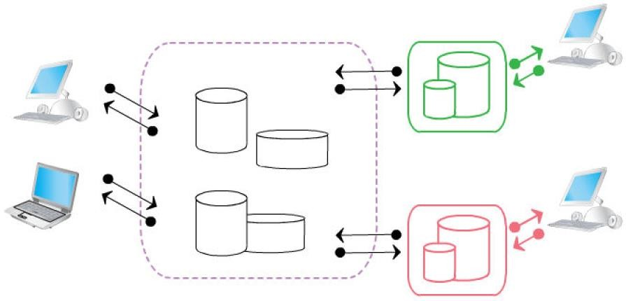
Application Boundary
Border between application being measured and external applications
8

Slide 9
FPA – Components
Transactions (Transactional Components)
External Inputs (information input)
External Inquiries (no derived data, data retrieval):
External Outputs (derived data, algorithms):
Data at rest (Data components)
Internal Logical Files (maintained internally)
External Interfaces Files (maintained by external apps)

Slide 10
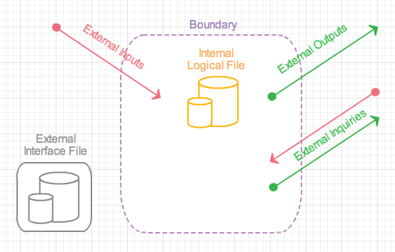
FPA – Components

Slide 11
Components
Each component rated as Low, Average or High
Based on (perceived) complexity
Points are assigned based on the rating
Question: How to evaluate complexity?

Slide 12
Break things up into even smaller pieces!
Transaction
Dependent on data transferred
Dependent on data stored
Data at rest
Dependent on data stored
Independent of data transferred

Slide 13
Smaller Pieces
Data Element Type (DET)
Dynamic user recognizable fields
Controls (things that invoke actions)
Used to estimate complexity of both transactions and data

Slide 14
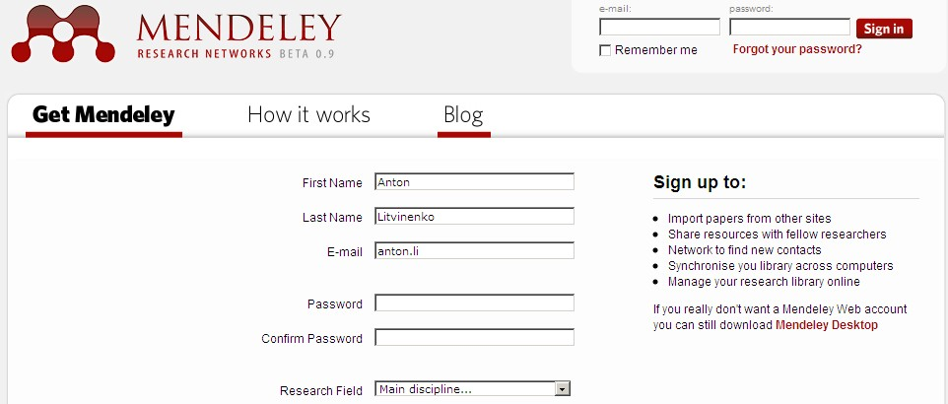
Data Element Type – Examples
DET-s

Slide 15
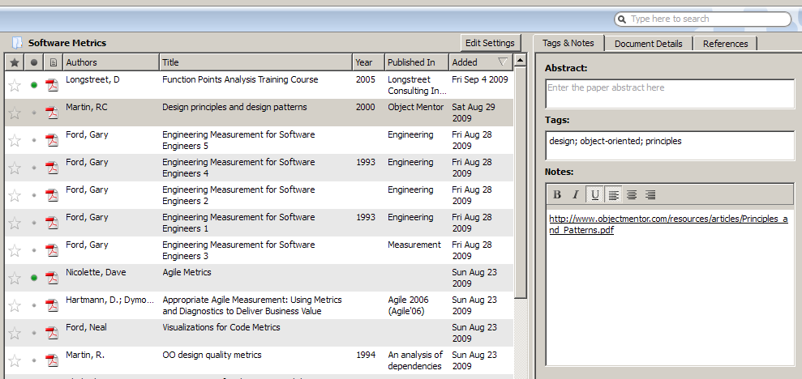
Data Element Type – Examples
DET-s
Repeated DET-s. Count only once

Slide 16
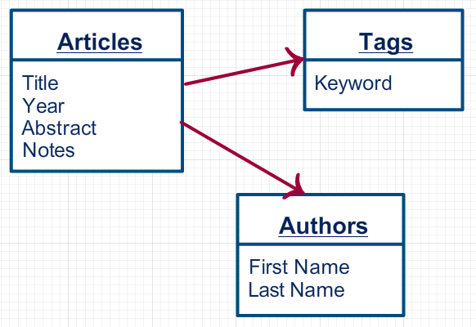
Data Element Type – Examples

Slide 17
Data Element Type – Examples
DET-s

Slide 18
Smaller Pieces
Data Element Type (DET)
Dynamic user recognizable field
Record Element Type (RET)
User recognizable subgroup of data elements in internal logical file or external interface file
For relational databases typically one Internal Logic File (table) = one Record Element Type

Slide 19
Record Element Type – Examples
1 RET each

Slide 20
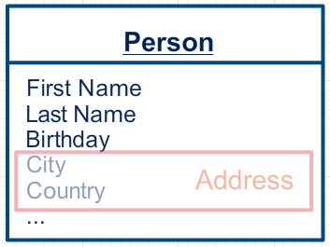
Record Element Type – Examples
2 RET-s

Slide 21
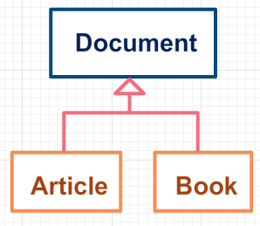
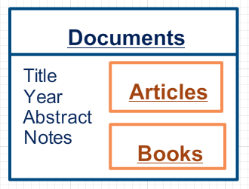
Record Element Type – Examples
Inheritance in object oriented development
Table per object hierarchy in relational database

Slide 22
Record Element Type – Examples
2 RET-s

Slide 23
Smaller Pieces
Data Element Type (DET)
Dynamic user recognizable field
Record Element Type (RET)
User recognizable subgroup of data elements in internal logical file or external interface file
File Type Referenced (FTR)
File type referenced by transaction (internal logical file or external interface file)

Slide 24
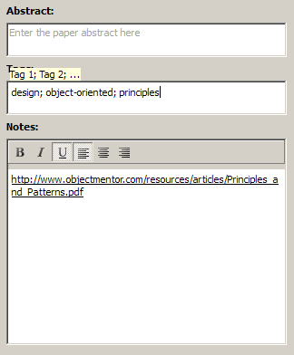
File Type Referenced - Examples
Edit article details
Abstract
Tags
Notes

Slide 25
FTR-s For Edit Article Details
Not referenced
FTR-s

Slide 26
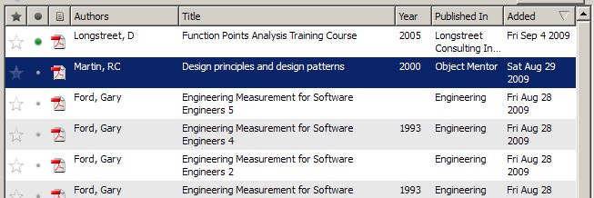
File Type Referenced Examples
How many FTR-s for “List of Articles”?
Tables: Articles, Authors, Tags

Slide 27
Components

Slide 28
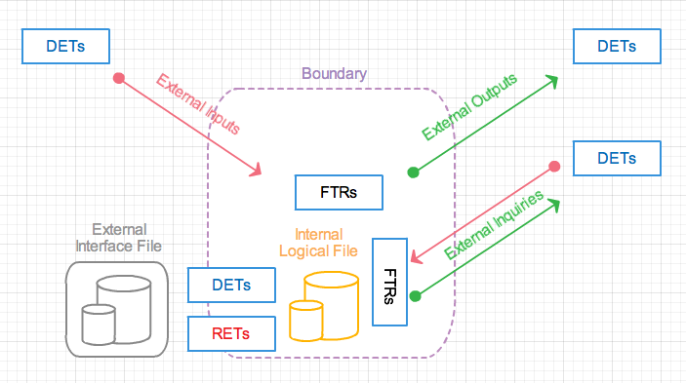
Components and DETs, RETs, FTRs

Slide 29
Function Points – Context
Identify Application Boundaries
Count Transactional Functions

Slide 30
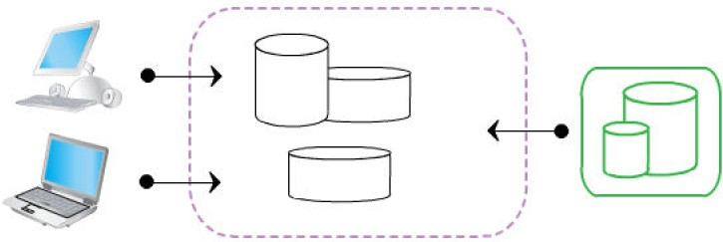
External Inputs
Information flows into the application
Online, user inserted, from other application

Slide 31
External Inputs – Examples

Slide 32
External Inputs – Examples
EI

Slide 33
External Inputs
Elementary process in which data or control information crosses the boundary from outside to inside
Data is maintained = added, changed or deleted
Application is controlled (manipulated, behavior is changed)
Rated based upon Data Element Types and Files Type Referenced

Slide 34
External Inputs → Function Points
Files Referenced | Data Elements (DET-s)
(FTR-s) | 1 – 4 | 5 – 15 | > 15
1 | Low (3) | Low (3) | Average (4)
2 | Low (3) | Average (4) | High (6)
> 2 | Average (4) | High (6) | High (6)
Low → 3 function points
Average → 4 function points
High → 6 function points

Slide 35
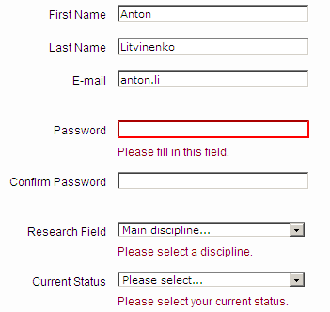
External Inputs – Examples
External Inputs include error messages!
All errors messages are counted as 1 Dynamic Element Type

Slide 36
External Inputs – Data Types
Business data: customer name, number of credits for course, … → updates Internal Logical Files (ILF-s)
Control data: printer port, number of copies, …
→ may or may not update ILF-s
Rules data: number of days before registration closes, min amount eligible for free shipping → updates ILF-s

Slide 37
External Inputs
Data element types for External Inputs
Fields, Controls, Messages (both error and confirmation)
Calculated values that are stored
Cancel – not counted in EI
Data doesn't cross boundary – noting changed, edited or deleted
State or behavior of application is not changed

Slide 38
These are NOT External Inputs
Login screens
Should be counted as External Inquiry
(Static) menus, link, navigational screens
Usability, not functionality

Slide 39
External Inputs – Identification Rules
Data is received from outside the app boundary
Maintains data in Internal Logical Files
Process is self contained and leaves the application in consistent state
Typical vocabulary
Add, Change, Delete, Modify, Remove, Edit, Enable, Save, Store, Submit, ...

Slide 40
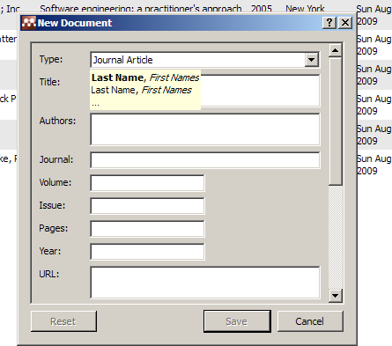
Exercise – Rate External Input

Slide 41
Function Points – Context
Identify Application Boundaries
Count Transactional Functions
External input (EI)
External output (EO)
External enquiry (EQ)

Slide 42
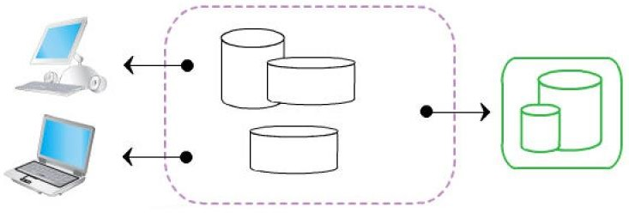
External Outputs
Derived information flows from the application
Algorithms, calculations
Reports, graphs, charts

Slide 43
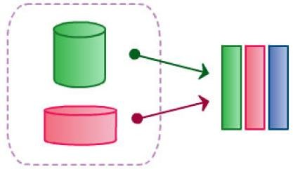
Derived Information

Slide 44


External Outputs – Examples
EO

Slide 45
External Output
Elementary process in which derived data passes across the boundary from inside to outside
Based on internal logical files and/or external interface files
Data processed beyond direct retrieval and editing from internal logical files or external interface files
Rated based upon Data Element Types and Files Type Referenced

Slide 46
External Outputs → Function Points
Files Referenced | Data Elements (DET-s)
(FTR-s) | 1 – 5 | 6 – 19 | > 19
1 | Low (4) | Low (4) | Average (5)
2 – 3 | Low (4) | Average (5) | High (7)
> 3 | Average (5) | High (7) | High (7)
Low → 4 function points
Average → 5 function points
High → 7 function points

Slide 47
External Outputs
Notification messages – result of processing = calculation
Data element types for External Outputs
Error messages
Calculated values on reports
Values on reports retrieved from application
Recursive DET-s counted only once!
External Outputs can have input side
Report configuration, ...

Slide 48
These are NOT External Outputs
Error message, confirmation message
Parts of External Outputs or other transactions
Reports without derived data
External Inquiries

Slide 49
External Outputs – Identification Rules
Data is sent from the app boundary to outside
Process is self contained and leaves the application in consistent state
Typical vocabulary
Browse, Display, Query, Report, View, Select, Request, Retrieve, Aggregate, Calculate

Slide 50

External Outputs – Identification Rules
Data ordering produces the same external output → counted only once!

Slide 51
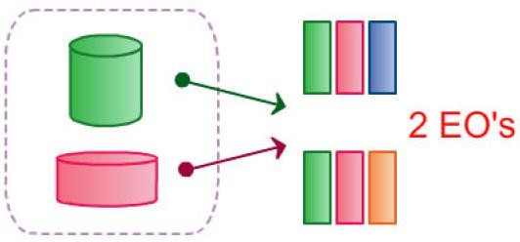
External Outputs – Identification Rules
Different derived data from the same data → different external outputs!

Slide 52
Example – Rate External Output

Slide 53
External Inquiries
Information flows from the application
Existing, already stored data
Input side and output side
Reports, graphs, charts,

Slide 54
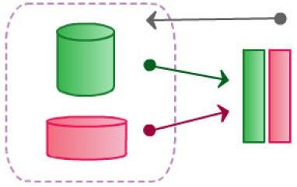
External Inquiries
Existing data + Input and output sides

Slide 55
External Inquiries
Elementary process with both input and output components that result in data retrieval from one or more internal logical files and/or external interface files
Does not maintain any internal logical files
Does not contain derived information
Rated based upon Data Element Types and Files Type Referenced

Slide 56
External Inquiries – Examples
Input: customer name in the search field
Output: list of customers by name
Input: click on the document title
Output: document details

Slide 57

External Inquiries – Examples
1 EQ

Slide 58
External Inquiries → Function Points
Files Referenced | Data Elements (DET-s)
(FTR-s) | 1 – 5 | 6 – 19 | > 19
1 | Low (3) | Low (3) | Average (4)
2 – 3 | Low (3) | Average (4) | High (6)
> 3 | Average (4) | High (6) | High (6)
Low → 3 function points
Average → 4 function points
High → 6 function points

Slide 59
External Inquiries – Data Types
Pagination: NEXT and BACK buttons – recursive information, counted as the same function
Messages are DET-s!
“data not found” = 1 DET-s

Slide 60
These are NOT External Inquiries
Error message, confirmation message
Parts of External Inquiries or other transactions
Screens with derived data
External Outputs

Slide 61
External Inquiries – Identification Rules
Request enters the boundaries, result exits the boundaries
Data retrieval, no derived data
Input and Output together form an elementary process
Data is not maintained
Typical vocabulary
Browse, Display, Fetch, Find, List, Drop-down, Select, View, Query, Report, ...

Slide 62
Function Point Analysis
Identify Application Boundaries
Count Transactional Functions
Count Data Functions
External Input (EI)
External Output (EO)
External inQuiry (EQ)
Internal Logical File (ILF)
External Interface File (EIF)
71

Slide 63
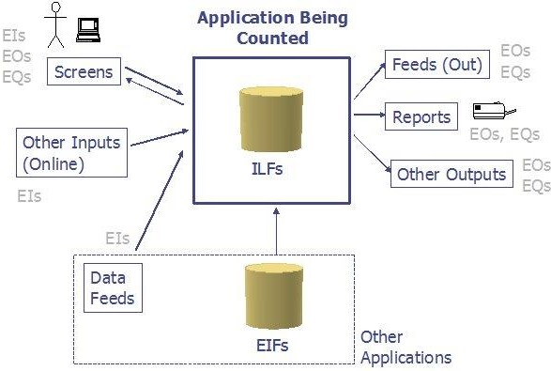
How it all fits together
© Alvin Alexander, 2004

Slide 64
Function Point Analysis
Identify Application Boundaries
Count Transactional Functions
Count Data Functions
How to count ILFs and EIFs
?
External Input (EI)
External Output (EO)
External inQuiry (EQ)

Slide 65
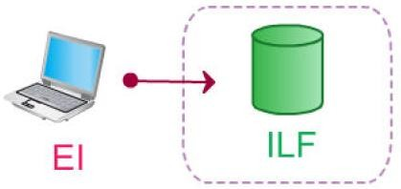
Internal Logical Files
Data that resides within app. boundaries
Business data, control data, rules based data

Slide 66
Internal Logical Files – Examples
3 ILF-s

Slide 67
Internal Logical Files – Data Types
Business data: course name, address, student
Control data: printer port, copies, database url
Rules based data: registration criteria, grading scheme

Slide 68
Internal Logical Files – Examples
Application configuration stored on hard drive
If maintained through the application
Log files

Slide 69
Internal Logical Files
Group of logically related data residing entirely within application boundary
Maintained by External Inputs
Has at least one Record Element Type
Rated based upon Data Element Types and Record Element Types

Slide 70
Internal Logical Files → FP-s
Record Elements | Data Elements (DET-s)
(RET-s) | 1 – 19 | 20 – 50 | > 50
1 | Low (7) | Low (7) | Average (10)
2 – 5 | Low (7) | Average (10) | High (15)
> 5 | Average (10) | High (15) | High (15)
Low → 7 function points
Average → 10 function points
High → 15 function points

Slide 71
Exercise – Rate ILF-s

Slide 72
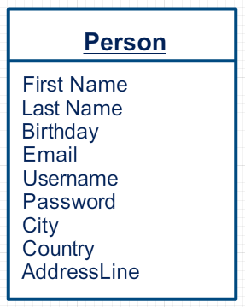
Exercise – Rate ILF

Slide 73
Internal Logical Files – Identification Rules
User identifiable logical grouping
Data is maintained within application boundaries
Data is modified via one or more External Inputs

Slide 74
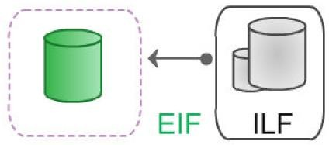
External Interface Files
Data that resides outside app. boundary
Internal data of other application

Slide 75
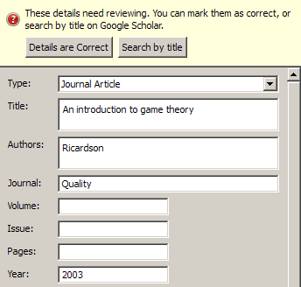
External Interface Files – Examples
Google Scholar is EIF

Slide 76
External Interface Files
Group of logically related data residing entirely outside application boundary
Maintained by another application
Data is retrieved during External Output or External Inquiry
Rated based upon Data Element Types and Record Element Types

Slide 77
External Interface Files → FP-s
Record Elements | Data Elements (DET-s)
(RET-s) | 1 – 19 | 20 – 50 | > 50
1 | Low (5) | Low (5) | Average (7)
2 – 5 | Low (5) | Average (7) | High (10)
> 5 | Average (7) | High (10) | High (10)
Low → 5 function points
Average → 7 function points
High → 10 function points

Slide 78
External Interface Files – Identification Rules
User identifiable logical grouping of information
Data external to application

Slide 79
Exercise – Rate EIF

Slide 80
Function Points – Context
Identify Application Boundaries
Count Transactional Functions
Count Data Functions
Determine Unadjusted FP Count

Slide 81
Value-Adjusment Factor (VAF)
VAF is a “factor” that takes into account non- functional requirements, e.g.:
Required performance (transaction rate) Required reliability
Required usability (end-user efficiency) Etc.
●
●
●
Not always used because all this is usually part of the cost estimation model

Slide 82
Shortcomings of FPA
Suitable mostly for form-based database apps
Requires experience
Experienced FP raters have variance of +/- 10%
Less experienced ones +/- 20%
Requires detailed reqs & high-level design
Time-consuming
“Dutch Method”: for each ILF, 3 EIs, 2 Eos, 1 EQ; for each EIF, 1 EO and 1 EQ
UFP = 35 * ILF + 15 EIF
Impractical for very large projects (> 10K FPs)
95

Slide 83
Extensions of FPs
We have seen FP definitions of the Intl. Function Point User Group (IFPUG)
Alternatives
Story points (agile – more next week)
COSMIC FPs – finer-grained; based on continuous size scale rather than discrete
OMG Automated Function Points – similar to IFPUG but strictly defined; meant for measuring (not estimating) already developed software
“per-FP” software pricing models
Measuring defects-per-FP for contract penalties

Slide 84
Is this stuff used at all?
Surely yes judging by
User groups worldwide
Project databases, e.g. ISBSG documents 5000+ projects counted using FPs
50K+ projects counted according to IFPUG + others by COSMIC
Several commercial tools
Not universal though…
Makes more sense in organizations with large portfolios of projects

Slide 85
FP Tools
Many tools can speed up/automate some FP count
SPR KnolwedgePLAN
PRICE Systems TruePlanning
SCOPE
Others: check “Software Parametric Models” in Wikipedia
Also – many FP Excel templates, see link on course web site

Slide 86
References
D. Longstreet, Function Points Analysis Training Course
http://bit.ly/G6WIx
Alvin Alexander: How to Determine Your Application Size Using Function Points. BorCon 2004 Proceedings
http://tinyurl.com/8mbofd8
http://conferences.embarcadero.com/article/32094 #SampleCount
102

